Slide 1
Easing into Scripting with Windows PowerShell
Andy Levy
SQL Saturday #
PLACE
DATE
Notes:
Goal isn’t to make you powershell experts. Just get an understanding and get you started exploring it for yourself. Maybe take it back to your sysadmins too
How many DBAs? Developers?
How many more than DBAs/Developers?
How many looked at PowerSHell?

Slide 2
Our Sponsors

Slide 3
About Me
15+ years in IT & development
Insurance & Real Estate
SQL, Classic ASP, .NET, scripting
Notes:
First exposure to SQL Server was 6.5
Had to use DB2 on mainframe as well at the time
Skipped over SQL Server 2005 & 2008

Slide 4
Memory Lane
Batch/CMD
Windows Scripting Host
4DOS, 4NT, Take Command, Cygwin
PowerShell
Notes:
3rd generation of MS scripting tech on Windows

Slide 5
What is PowerShell?
Core Windows Component
Windows Management Framework
Built on the .NET Framework
Notes:
Since 2009 (Win7/2008R2), Each release of Windows sees a new release of PowerShell
Common engineering criteria – to be on the server platform, you MUST have a PowerShell interface
Windows Management Framework is a collection of technologies for managing Windows.

Slide 6

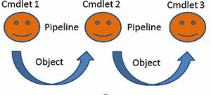
What is PowerShell?
.NET Framework meets UNIX shells
Cmdlets
Pipeline
Notes:
Ideas from UNIX shells – many small tools working together. No accident – many PowerShell team members have UNIX backgrounds
UNIX slings text around, PowerShell uses objects
Sed, awk, find, ls, cp, grep
Everything is an object whether you realize it or not
Cmdlets
Kind of like programs
Kind of like functions
Kind of like commands
Emit objects
Pipeline lets us string a number of commands together
1-liners!
Makes a great glue – SharpSVN to SSRS web service
Image source: https://www.simple-talk.com/sql/sql-tools/the-posh-dba-grown-up-powershell-functions/

Slide 7
Discoverability
Naming conventions
Get-Help
Get-Command
Get-Member
Notes:
PowerShell will tell you what you need to know
Verb-Noun convention
Standardized verbs
SQLPS breaks the guidelines
Tab completion
You don’t have to memorize everything

Slide 8
Built-In Functionality
Advanced functions
Multiple output streams
Help authoring
ISE
Notes:
Don’t be afraid of “advanced”
Parameter validation
Write-Debug, Write-Verbose, Write-Warning, Write-Progress
Built-in help handling
PowerShell comes with the ISE
Lots of competitors, but with v3 most people moved right into the default
Sapien has an expensive scripting environment that people like – but most find the ISE enough

Slide 9
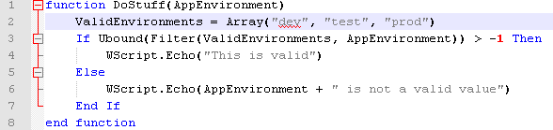

Advanced Can Be Easier!
Notes:
[ValidateNotNull()]
[ValidateNotNullOrEmpty()]
[ValidateRange()]
[ValidateScript()]
Caught myself today forgetting about ValidateScript()
If you've used validation attributes in MVC or C#, it'll look familiar

Slide 10


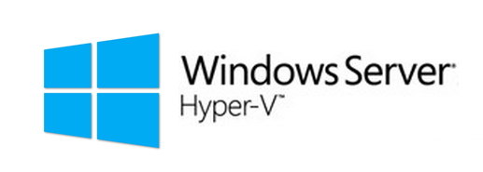








Modularity
Microsoft modules
Vendor modules
Community modules
Notes:
Manage your full stack! (report disk space)
Even manage network gear that complies with the Open Management Infrastructure spec.
PSCX, Chocolatey, PSGet, v5 PackageManagement
Write your own!
Good “glue” for other systems – SSRS script

Slide 11
Remote Access
Baked into many cmdlets
Send any block of script to a remote system to execute
Working with 1 system is just like working with 1000+ systems
Secure
Notes:
We’re used to doing things remotely – we don’t RDP to our SQL Servers all the time, right? RIGHT?
Cmdlets take the –computername parameter
Use invoke-command
Run stuff remotely from a Surface RT (which is now dead)!
Can manage Windows Azure environments remotely
Significantly reduce or eliminate the need to RDP into servers
Security
Secure channel for communicating between systems
By default, the credentials you’re logged in with are the credentials used by your scripts/cmdlets
Nothing can happen that you didn’t already have rights to do
Pssessions & invoke-command generally require local admin on the remote host
PSSessions
Like SSH
Connect via CLI, do stuff, run things
Can even establish a PSSession, then use that session from local cmdlets

Slide 12
Demo Time

Slide 13
Other Resources
Hey, Scripting Guy!
#powershell
powershell.reddit.com
MVPs & community members
Microsoft Virtual Academy
Notes:
PowerScripting Podcast, Don Jones, Jeff Hicks, Joel Bennett, Warren Frame (psCookiemonster), Mike Fal, Bill Fellows, Allen White, Kendal Van Dyke

Slide 14
Thank You!
Blog: therestisjustcode.wordpress.com
Twitter: @ALevyInROC
LinkedIn: linkedin.com/in/ALevyInROC
Notes:
Slides will be posted online

